Slide 1
Lecture 01 Introduction
CE346 – Microcontroller System Design
Branden Ghena – Fall 2024
Some slides borrowed from: Josiah Hester (Northwestern), Prabal Dutta (UC Berkeley)

Slide 2
Welcome to CE346/CS346!
Focus on hardware/software systems and their design
Hardware/Software co-design
How do you write software that interacts with hardware?
How do you choose hardware to support software needs?
Sensors and Sensing
What can sensors do and how do they work?
How do you write applications that sense the world?

Slide 3
Asking questions, four ways
You can always ask questions during lecture!
I’ll let you know if I need to move on for now and answer you after class
We’ll take breaks during lecture
I’ll pause after each break to see if any questions came up
I will hang out after class for questions
Plenty of time to answer everyone
You can always ask questions on Piazza too
The class message board app

Slide 4
Today’s Goals
What are the goals of this course?
Why do I think embedded systems are so important?
How is the course going to operate?
Discuss hardware used for the course and some project ideas.

Slide 5
Outline
Who and Why
Embedded Systems
Course Overview
Class Hardware
Project Ideas

Slide 6
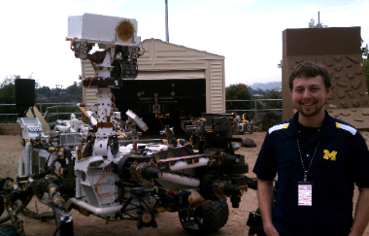
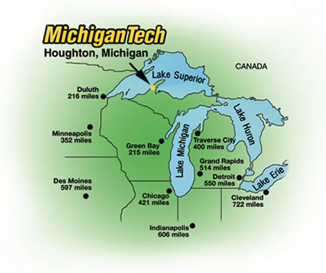
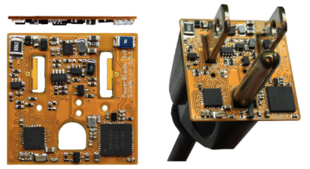
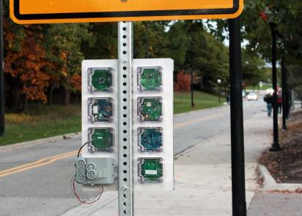





Branden Ghena (he/him)
Assistant Faculty of Instruction
Education
Undergrad: Michigan Tech
Master’s: University of Michigan
PhD: University of California, Berkeley
Research
Resource-constrained sensing systems
Low-energy wireless networks
Embedded operating systems
Teaching
Computer Systems
CS211: Fundamentals of Programming II
CS213: Intro to Computer Systems
CS343: Operating Systems
CE346: Microcontroller System Design
CS397: Wireless Protocols for the IoT
Things I love

Slide 7

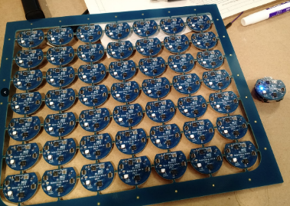
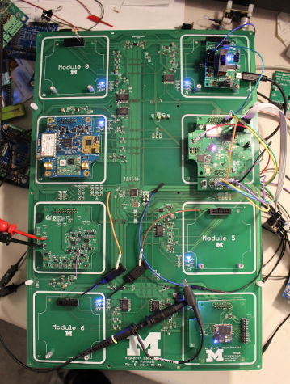
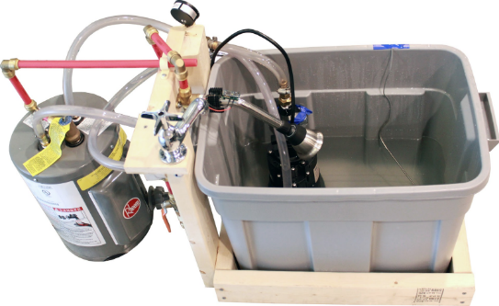
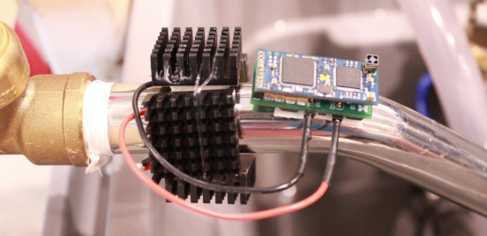
Research area: resource-constrained embedded systems
Most interesting to me: the interfaces
Hardware and software
Applications and OS
Communication

Slide 8
Faculty: now I can choose what to teach!
Goal: provide classes that teach more advanced embedded systems topics
Hopefully, generally useful to other nearby domains of CS and ECE too!
Result: this course!
Course goal: introduce students to hardware-software interactions
Practical hands-on experience with microcontrollers and sensors
Open-ended project where students can choose their specific focus

Slide 9
Outline
Who and Why
Embedded Systems
Course Overview
Class Hardware
Project Ideas

Slide 10
What is an embedded system?
A computer built into a device such that the device is interacted with, not the computer
E.g., not a desktop or laptop
(although many of those deal with overlapping hardware/software issues)
Includes many domains
Robotics
Industrial processes
Smart home
Smart city
Wearables and health sensing
Internet of Things

Slide 11
Discussion: identify some embedded systems
What devices that you might not usually consider as computers actually have embedded computers in them?
Talk with the others around you
Goal: come up some unique ideas
We’ll share ideas with the class afterwards

Slide 12
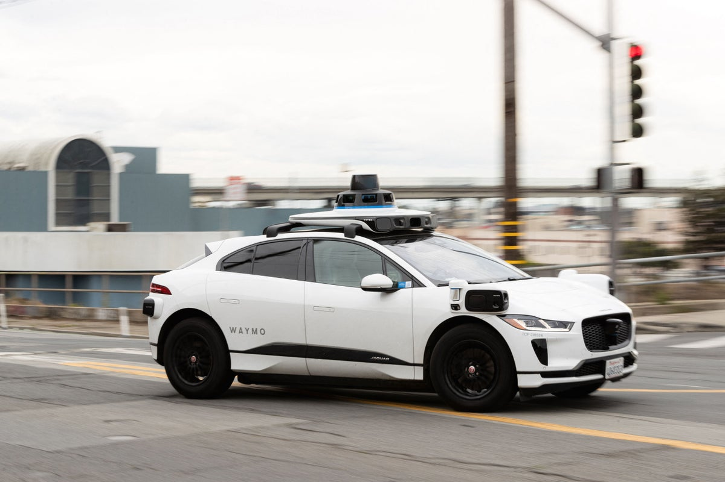
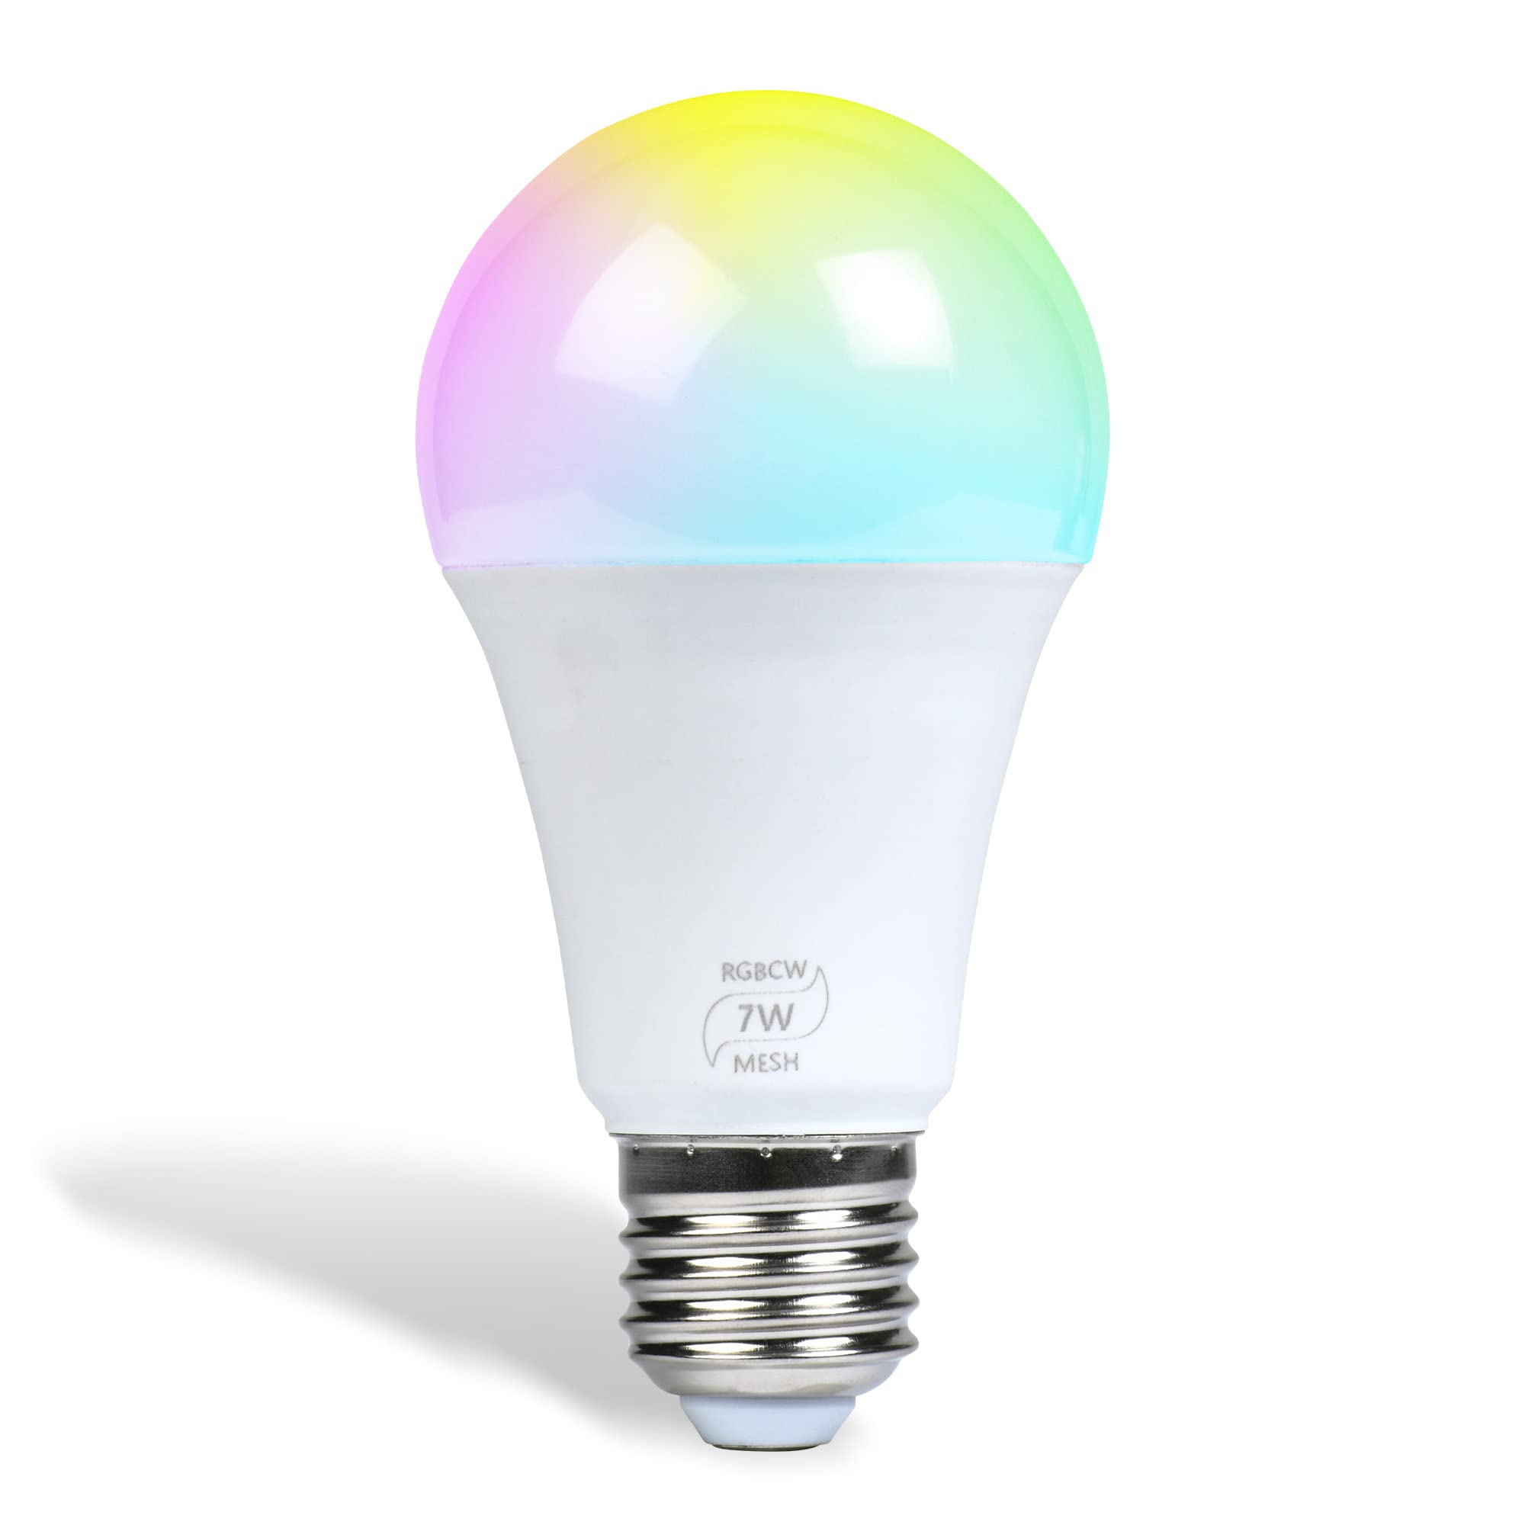
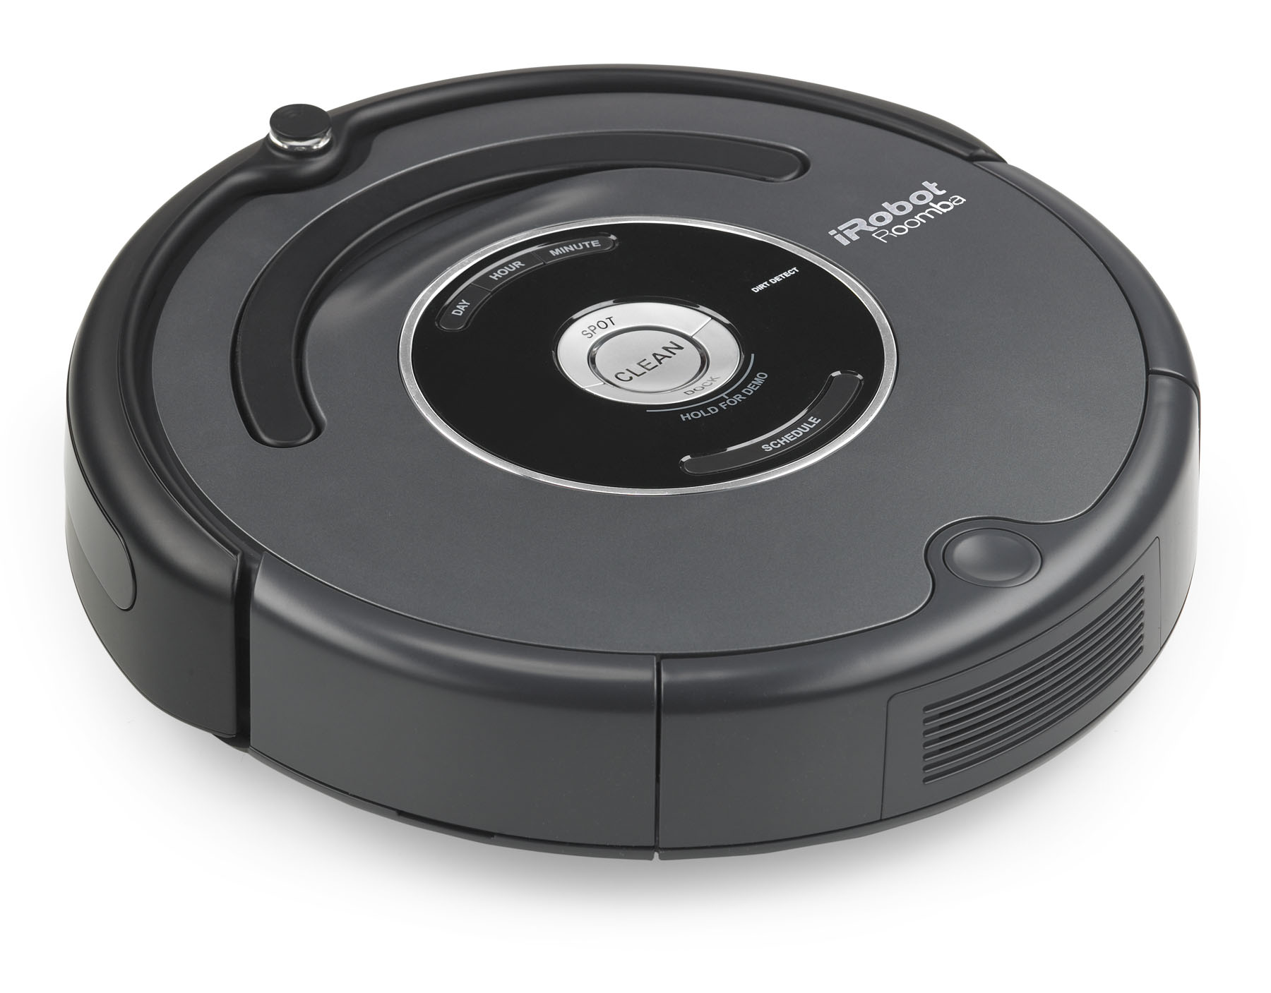
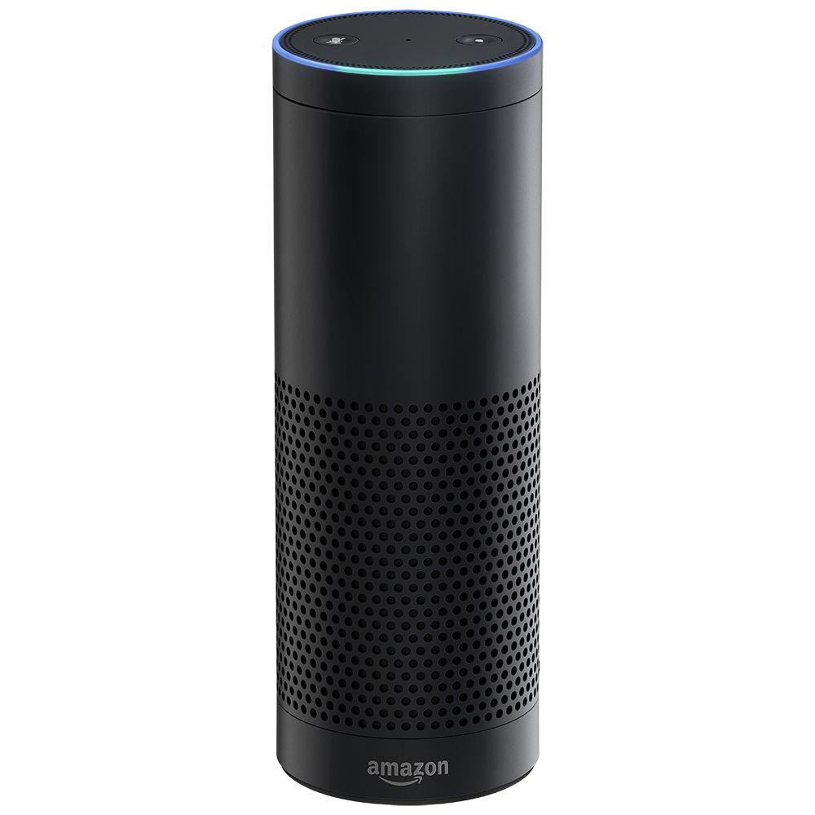
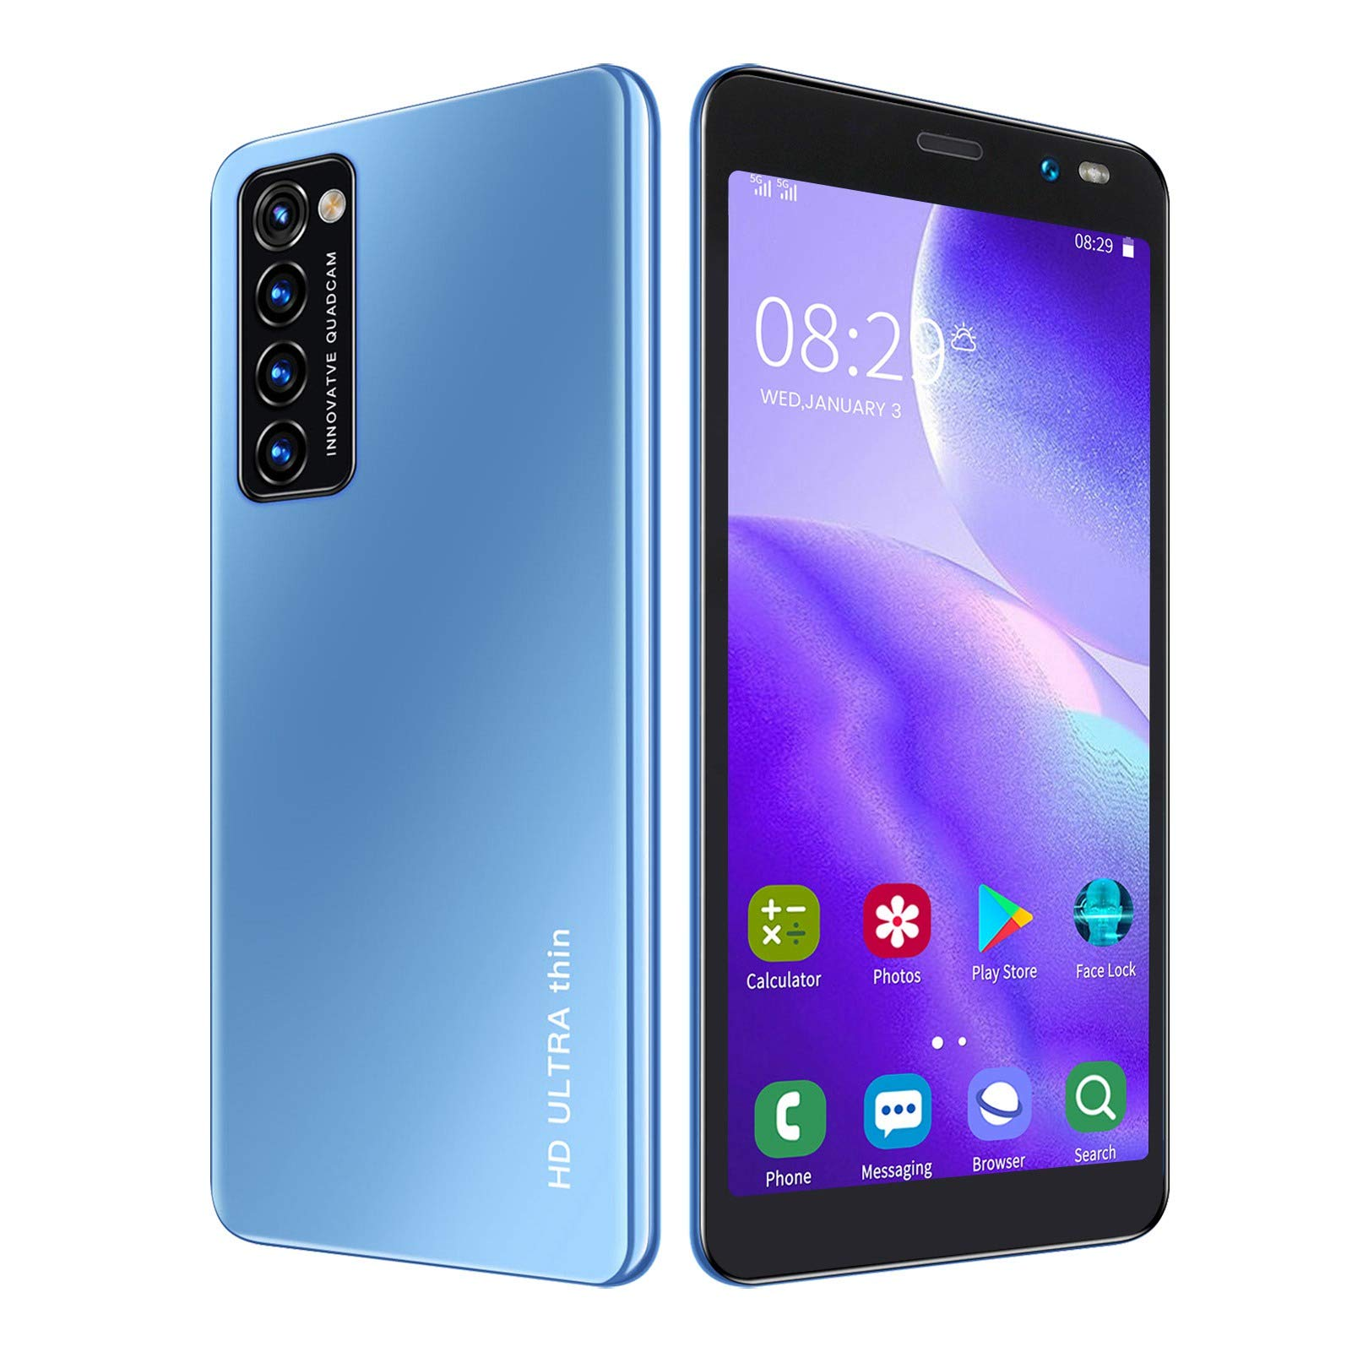
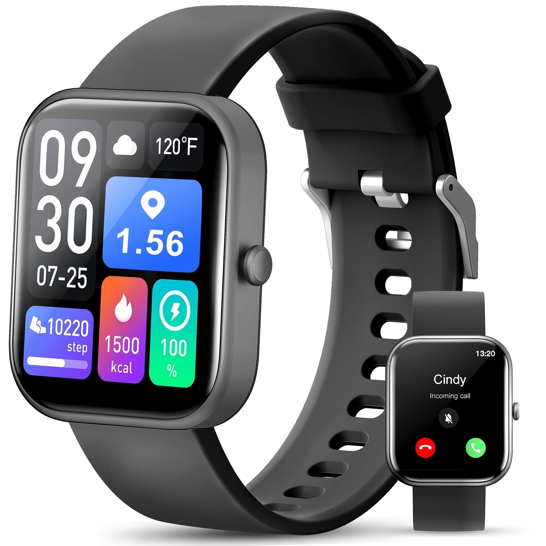
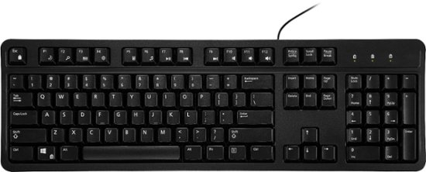
Discussion: what does and does not count
Share your thoughts
Is _____ an embedded system? Why or why not?
Smart lightbulb
Roomba
Autonomous vehicle
Smartwatch
Smartphone
Voice-assistant (Alexa)
Keyboard

Slide 13
Trend: embedded computers instead of custom hardware
Some embedded devices could be a state machine in custom hardware instead
However, computers are increasingly common in those cases
Embedded computers are increasingly cheap
More software developers than hardware developers

Slide 14
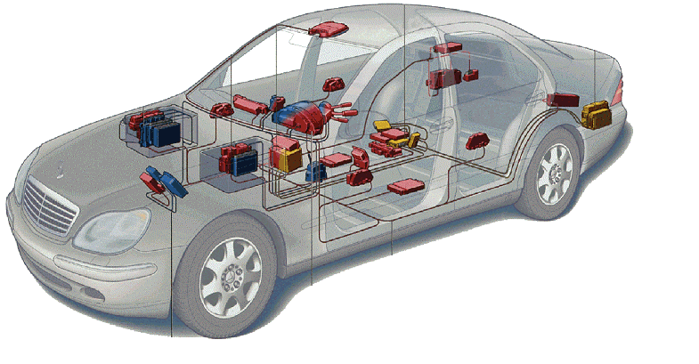
Related area: Cyber-Physical Systems
Systems that are part computational and part real-world
Example: autonomous vehicles
Combines multiple fields to handle this problem
Embedded Systems
Electronics
Controls
Software Engineering
Computer Theory
Automotive

Slide 15
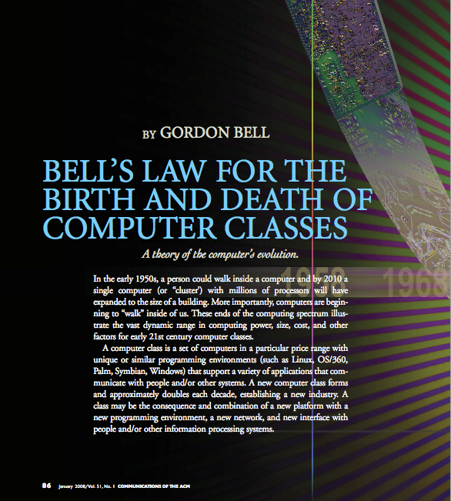
Bell’s Law: A new computer class every decade
“Roughly every decade a new, lower priced computer class forms based on a new programming platform, network, and interface resulting in new usage and the establishment of a new industry.”
- Gordon Bell [1972,2008]

Slide 16
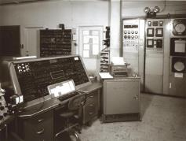
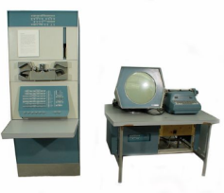
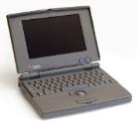
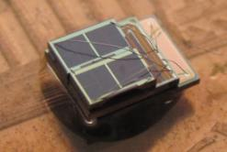

Classes of computation
Mainframe
[Bell et al. Computer, 1972, ACM, 2008]
Workstation
Laptop
Smart Sensors
Mini Computer
Ubiquitous
Personal Computer
Smartphone

Slide 17
Number of computers per person grows over time
Mainframe
1 per Enterprise
[Bell et al. Computer, 1972, ACM, 2008]
Workstation
1 per Engineer
Laptop
1 per Professional
log (people per computer)
Smart Sensors
Mini Computer
Ubiquitous
1 per Company
Personal Computer
100 – 1000’s per person
1 per Family
1 per person
Smartphone

Slide 18
Computer volume shrinks by 100x every decade
Mainframe
1 per Enterprise
100x smaller every decade
Workstation
1 per Engineer
[Nakagawa08]
Laptop
1 per Professional
Smart Sensors
Mini Computer
Ubiquitous
1 per Company
Personal Computer
100 – 1000’s per person
1 per Family
1 per person
Smartphone

Slide 19

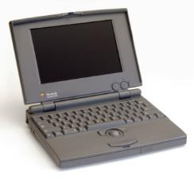

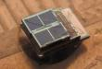
Price falls dramatically, enabling new applications
Mainframe
Workstation
Number Crunching
Data Storage
Laptop
productivity
interactive
Mini Computer
streaming
information
to/from the
physical
world
Smart Sensors
Personal Computer
Smartphone

Slide 20
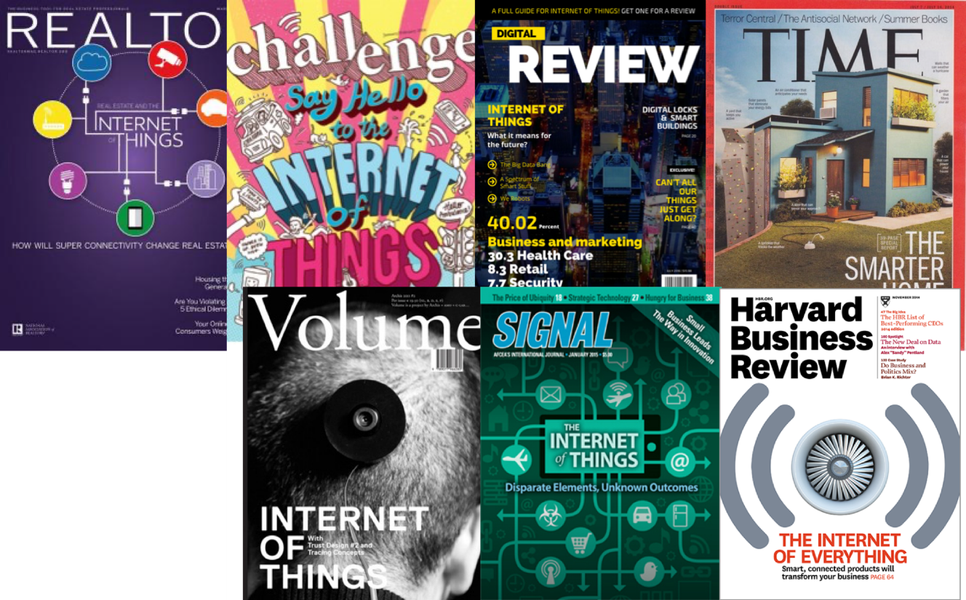

The Internet of Things (IoT)

Slide 21
Branden’s take on the Internet of Things
Key features
Computation
Local to the device
With some capability for arbitrary compute and storage
Connectivity
Almost certainly wireless
Likely Internet, possibly local
Interaction
Sensing or Actuation
Secondary features
Low energy
(Relatively) Low cost

Slide 22
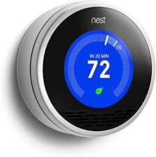
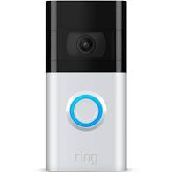
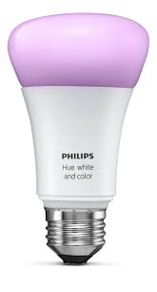

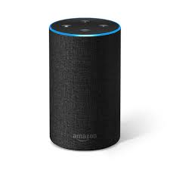
Some example Internet-of-Things devices

Slide 23
Thought experiment: motion-controlled lighting
What about motion-controlled lights?
Sensor detects motion and turns on the light
Each light is individually controlled by its sensor only
Would that still count as IoT?
Could that still be an embedded system?

Slide 24
Thought experiment: motion-controlled lighting
What about motion-controlled lights?
Sensor detects motion and turns on the light
Each light is individually controlled by its sensor only
Would that still count as IoT?
No
Missing communication aspect for sure, probably computation
Could that still be an embedded system?
Yes? Sensing + actuation packaged as a device
Again, computation could be lacking

Slide 25
Thought experiment: high-capability computing
What if the Nest thermostat was powered by an entire desktop?
8-core x86-64 processor, 32 GB RAM, 1 TB SSD
Would that still count as IoT?
Could that still be an embedded system?
Why don’t we see that in practice?

Slide 26
Thought experiment: high-capability computing
What if the Nest thermostat was powered by an entire desktop?
8-core x86-64 processor, 32 GB RAM, 1 TB SSD
Would that still count as IoT?
Doesn’t really feel right. Built in assumption of limitations.
Could that still be an embedded system?
Yes
Why don’t we see that in practice?
Cost

Slide 27
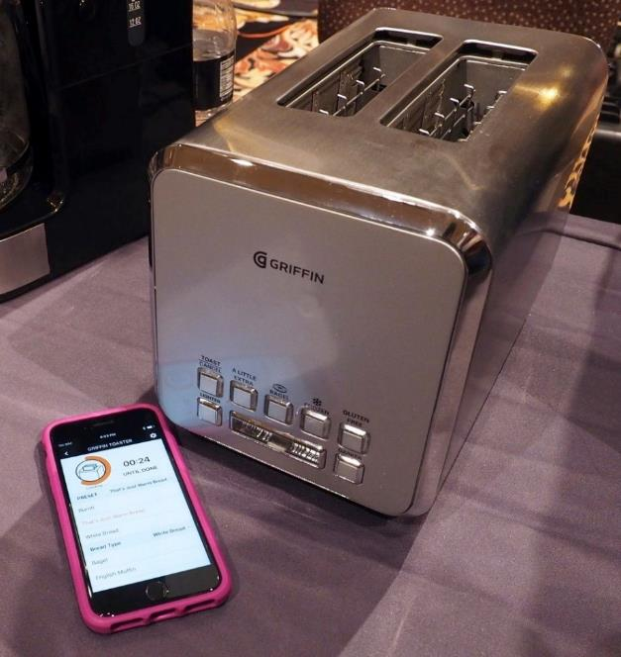
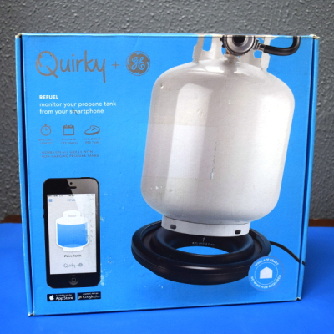
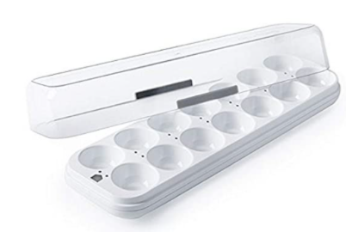
Warning: Internet of Crap

Slide 28
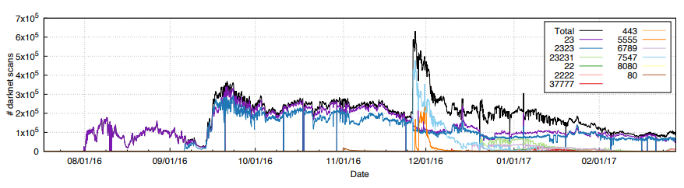
Internet of Insecure Crap
Mirai botnet (2016)
Takes control of up to 600,000 insecure connected devices
IP-attached cameras, DVRs, routers, printers
Used to DoS websites

Slide 29
What makes resource-constrained embedded systems interesting?
Focus on the real world
You can actually see the purpose and effects of your applications
Easily explainable to non-engineer humans
Challenging limitations
Limited memory and processing
Energy concerns

Slide 30
What makes resource-constrained embedded systems frustrating?
Challenging limitations
Limited memory and processing
Energy concerns
Full-stack development means problems could be anywhere
Hardware problems
Firmware problems
Software problems
Example: my first grad project eye-tracking glasses
Camera -> ADC -> FPGA -> Linux driver -> Linux app -> Network -> Visualizer app

Slide 31
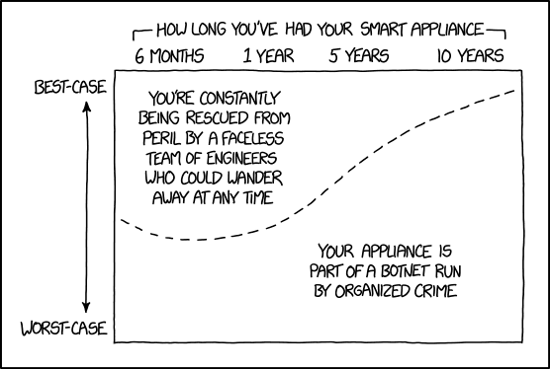
Break + xkcd
https://xkcd.com/1966/

Slide 32
Outline
Who and Why
Embedded Systems
Course Overview
Class Hardware
Project Ideas

Slide 33
Course Staff and Office Hours
Four PMs who previously took the class
Alex Huggins
Isa Gonzalez
Joseph Grantham
Lucas Takayasu
They will help out during labs and also provide lab office hours
Office Hours: TBD
We’ll post a schedule soon
Also by request! (especially during projects)

Slide 34
Course details – how to learn stuff
Lecture: Tuesdays and Thursdays 3:30-4:50pm
2122 Sheridan, Room 250
Provides background on everything we’ll be doing in labs
Lectures are automatically recorded so you can review them
No textbook for this class
Nobody seems to write a good one
The datasheet for our microcontroller (nRF52833) will be important though!

Slide 35
Asking Questions
Class and office hours are always an option!
We can do extra questions right after class too
Piazza: (similar to Campuswire)
Post questions
Answer each other’s questions
Find posts from the course staff
Post private info just to course staff
Post on Piazza – do NOT send me emails
Messages are kept in one place and stay “unanswered”
You can post directly to “Instructors” if it is private
Use that feature to request office hour appointments if desired
Or to tell me that you’re sick and can’t attend lab

Slide 36
Course grade components
42% Labs
6 labs at 7% each
Guided exploration of course concepts
Staff gives checkoffs as you complete parts
20% Quizzes
Four timed quizzes at 5% each
Covers lecture material from last two weeks
Probably in-class at the end of class, I’ll update you in advance
38% Final Project
Open-ended group project (will explain in a minute)

Slide 37
Class lab sessions
Lab: Fridays 1:00-2:50pm OR 3:00-4:50pm, Frances Searle 3220
Mandatory attendance for these
Let me know ASAP if you’re sick and will miss
Labs start next week Friday and are weekly from there
No lab this week!
Six labs total
When labs run out, I’ll use the time for project meetings with groups
Warning: labs won’t usually be finished during the lab sessions
You’ll have to work on them on your own time too
We’ll have office hours for checkoffs

Slide 38
Labs
MMIO and Interrupts
Virtual Timers
LED Matrix
Breadboarding
Audio Input/Output
I2C Accelerometer/Magnetometer
Labs will be partner work
You choose, but different partner each week
MUST work with a partner
Due one week from start of lab
Complete Checkoffs plus some Post-lab Questions due online

Slide 39
Quizzes
In-class, on-paper, closed notes quizzes
Usually about 15 minutes and held at the end of lecture
Cover the last two weeks worth of material
So make sure you’re up-to-date on what we’re talking about
First quiz is Tuesday, October 8th (third week of classes)

Slide 40
Final projects
Opportunity for you to apply your interests to this course
In groups of 2-3 students (maybe 4 for a really big idea)
Demonstrate course knowledge through any application
Microbit (99% required)
Various hardware I’ll have on hand
Small budget for purchasing additional stuff (up to $40 per person in team)

Slide 41
Project Logistics
Week 4: Proposals due
I’ll get you feedback in about a week
Week 6: Project Design Presentations
Short presentations in class about your proposed project and design
Chance to give each other useful feedback about how to proceed
Week 9-11: Labs are done and Fridays are used for update meetings
Exam Week: Live project demos!!
Public demo session
Tuesday of exam week (usually half of the class at a time for a 2-3 hour block)

Slide 42
Flexibility
Sometimes stuff just doesn’t work
Especially when we’re working with hardware
We can be flexible about those deadlines
If you’re having problems and tell us
Less flexible if you don’t communicate or if you started late
Takeaway: let us know if you’re having problems
Notes:
Bonus note

Slide 43
Architecture of a lecture
Full
Administrivia
+ stretch break
Open Question
Summary
+ Bonus
Attention
0
20
25
50
53
78
80
Time (minutes)

Slide 44
Outline
Who and Why
Embedded Systems
Course Overview
Class Hardware
Project Ideas

Slide 45
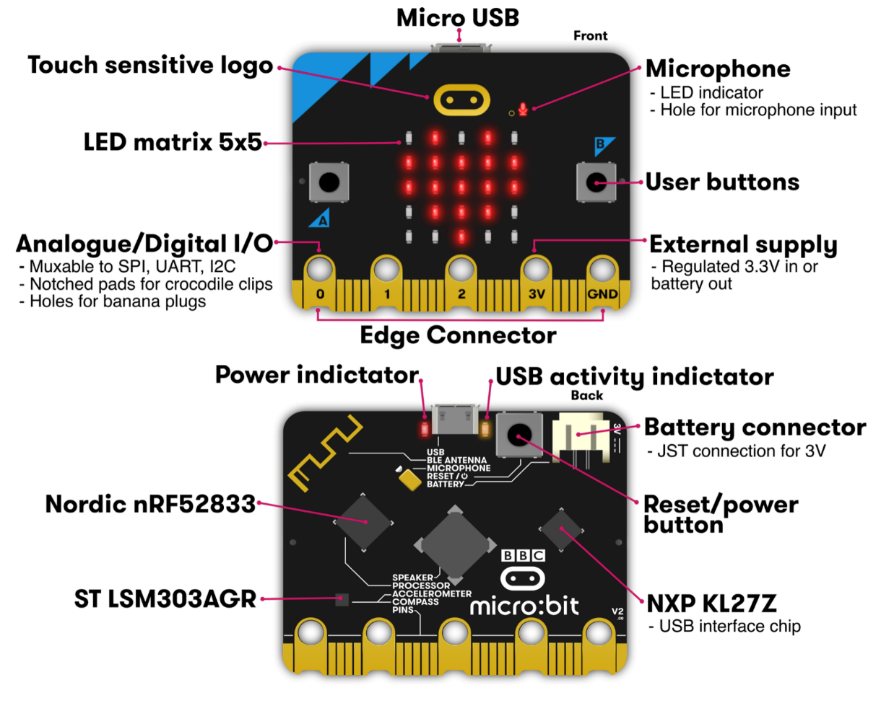
Micro:bit v2
Legacy from 1980s “BBC Computer Literacy Project”
Reimagined today
Under $20
Modern microcontroller AND sensors
Plan for class:
Explore most of its functionality

Slide 46
Getting your own Microbit
You do NOT need to buy your own Microbit
I have enough for everyone in the class to borrow one for the quarter
If you want your own though, they’re pretty cheap:
$17.95 Adafruit: https://www.adafruit.com/product/4781
$16.50 Sparkfun: https://www.sparkfun.com/products/17287
$20.99 Amazon: https://www.amazon.com/Seeed-Studio-BBC-Micro-Accelerometer/dp/B0BDFD1ZM1

Slide 47
Labs will use your own laptops
All labs will use your own computers
In the past we used the computers in CG50
About one computer would crash per lab session
Super crammed in there with no elbow room or walking room
And you had to physically go there to work on labs
Setup for your own computers won’t be that hard
Native MacOS or Linux works great
For Windows, VMWare Workstation + Ubuntu is pretty easy, but requires ~20 GB
Concern of mine: equal access to labs
If you don’t have a laptop or don’t think it’ll work, let me know!

Slide 48
Poll of the room
MacOS users
Linux users
Windows users
WSL users?
Other?

Slide 49
Reminder: No lab this Friday
Labs are Fridays
This Friday there are no lab sessions
You’ll be installing things on your machine to set it up for class
Try it on your own and see how it goes Even if you’ve never done it before, it’s not too difficult
We’ll have office hours next week in case you run into issues that you’re not sure how to resolve

Slide 50
Outline
Who and Why
Embedded Systems
Course Overview
Class Hardware
Project Ideas

Slide 51
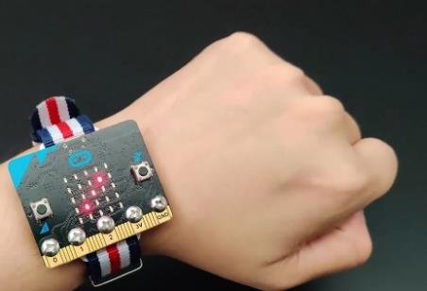
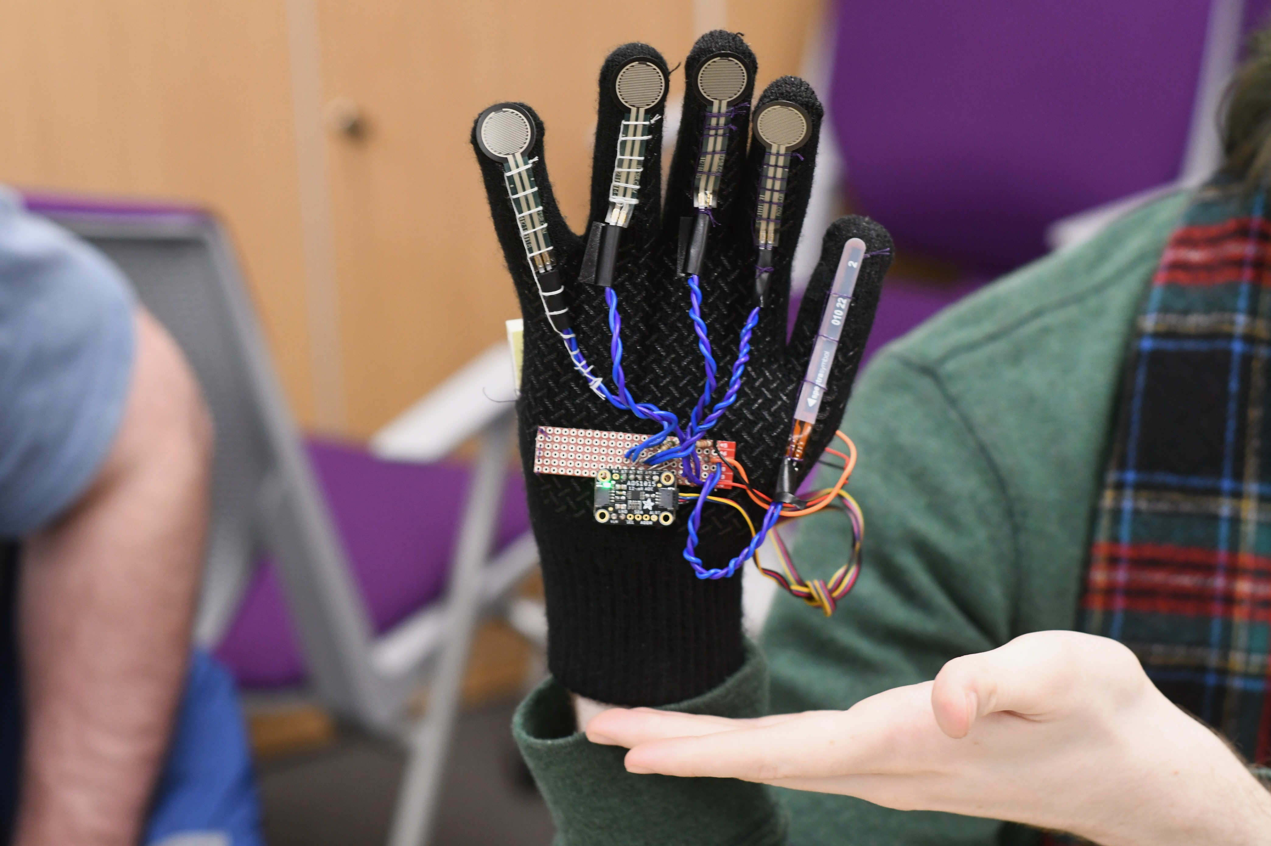
Project Ideas
Some ideas to get you thinking
Game with interesting control mechanism
Smart gloves
Smartwatch
Simple robotic systems
Projects can use
Multiple Microbits
A personal computer for some amount of coordination
Lots of different sensors or actuators
Go explore sparkfun.com

Slide 52
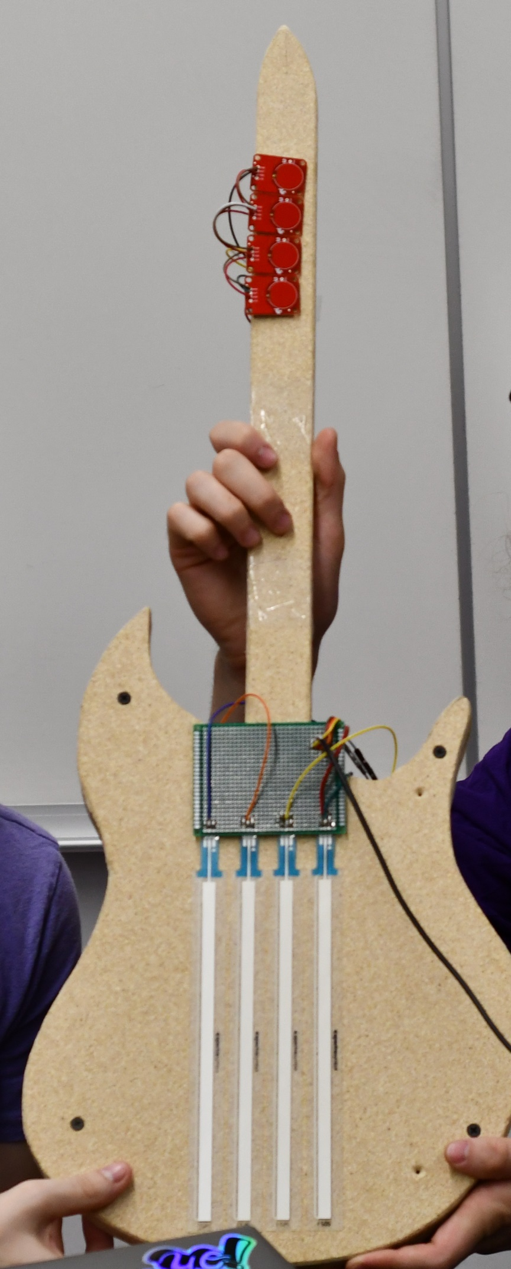
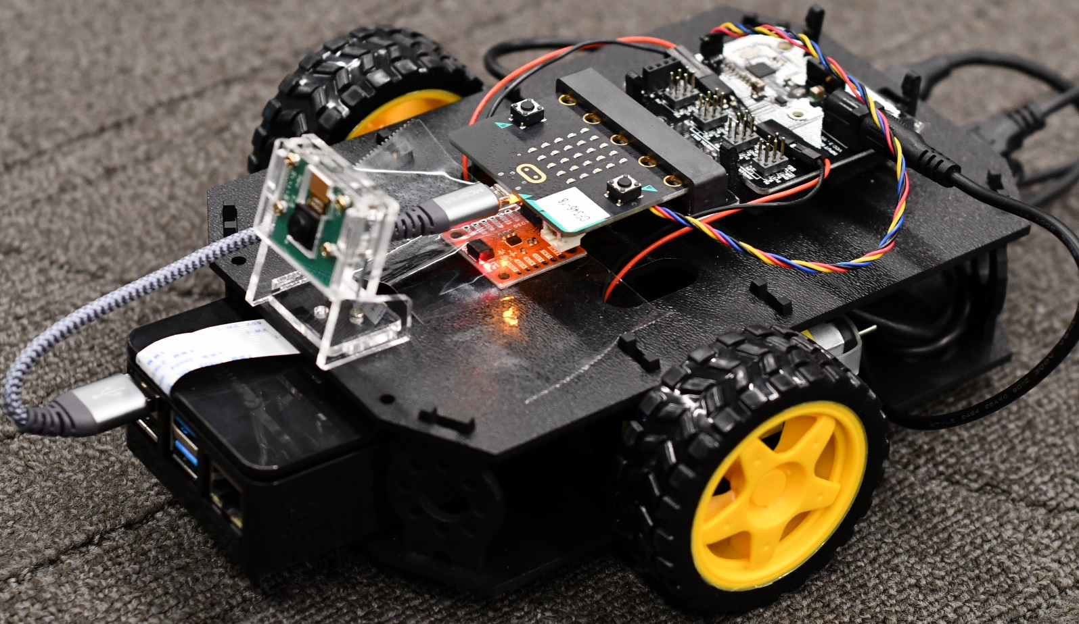
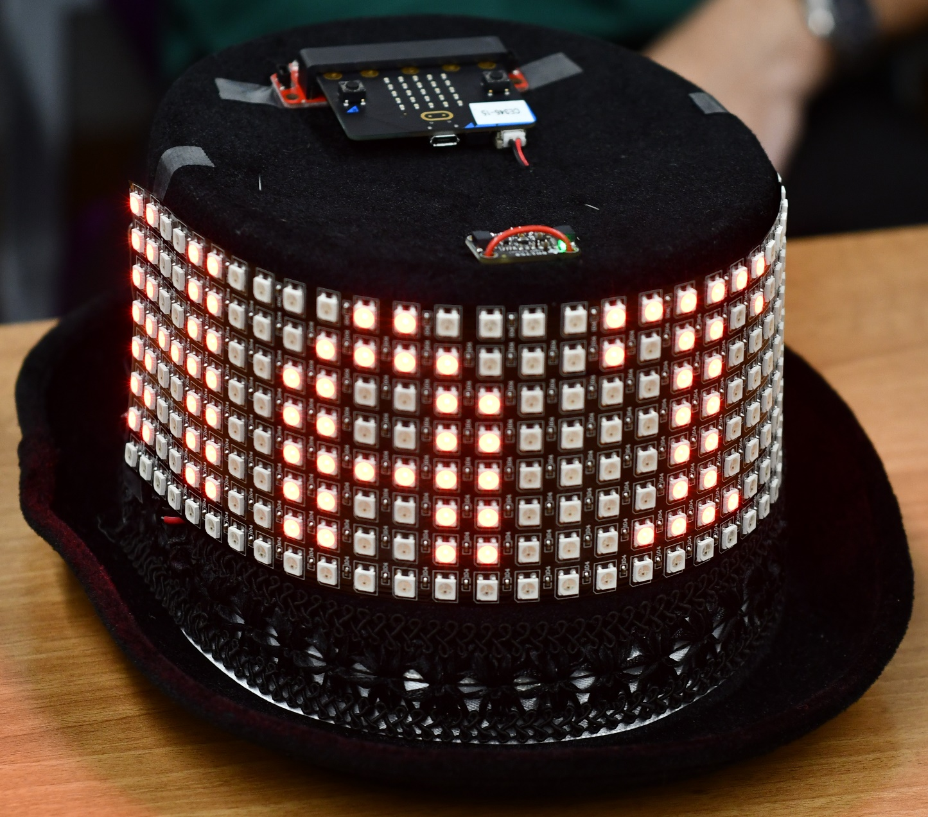
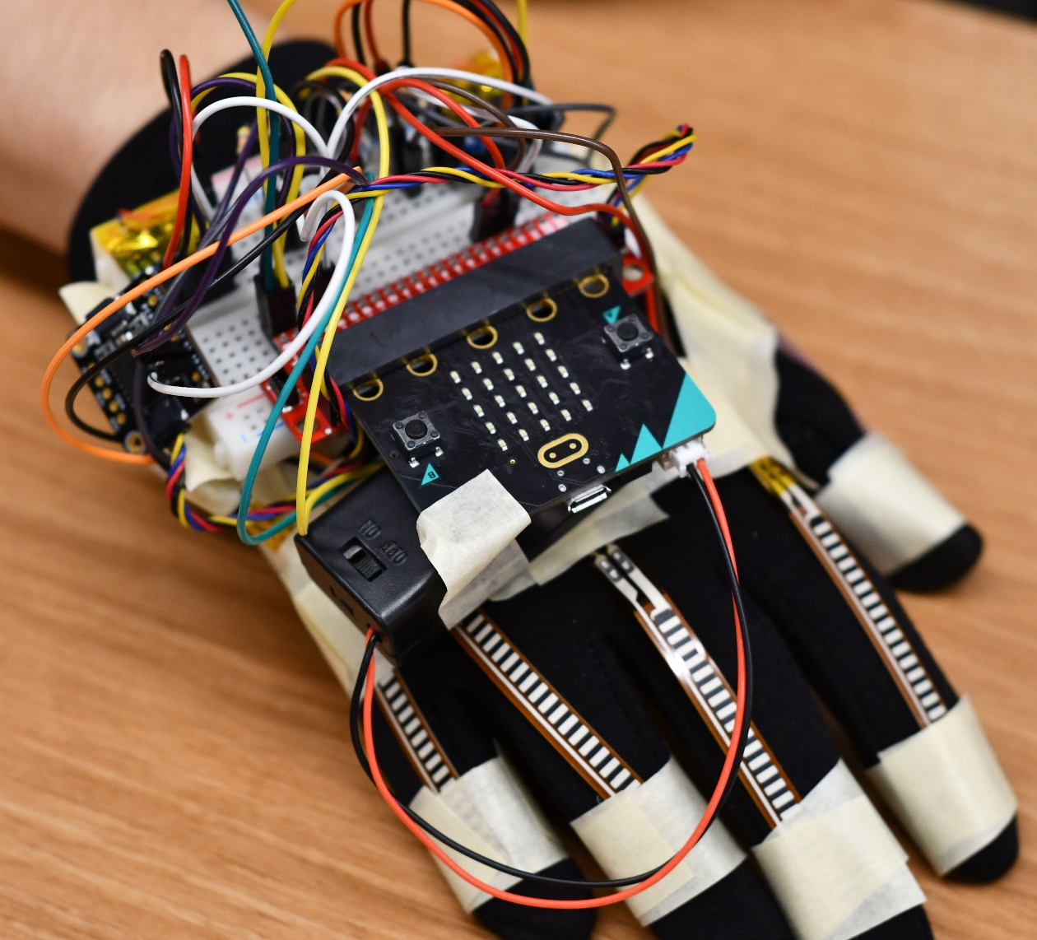
Some awesome Fall 2021 projects

Slide 53
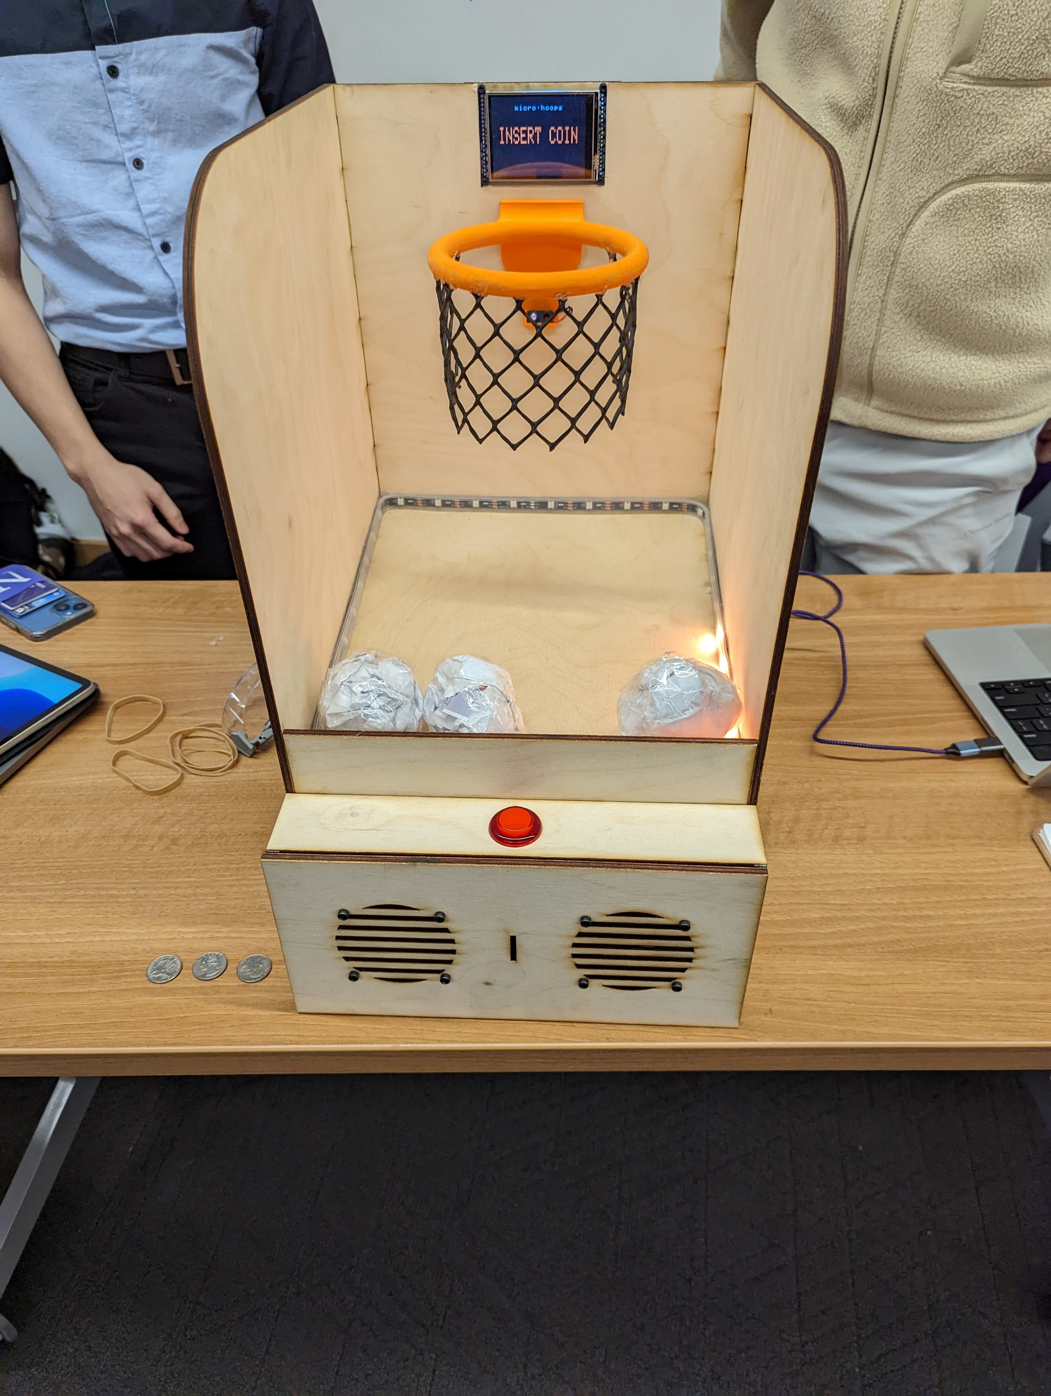
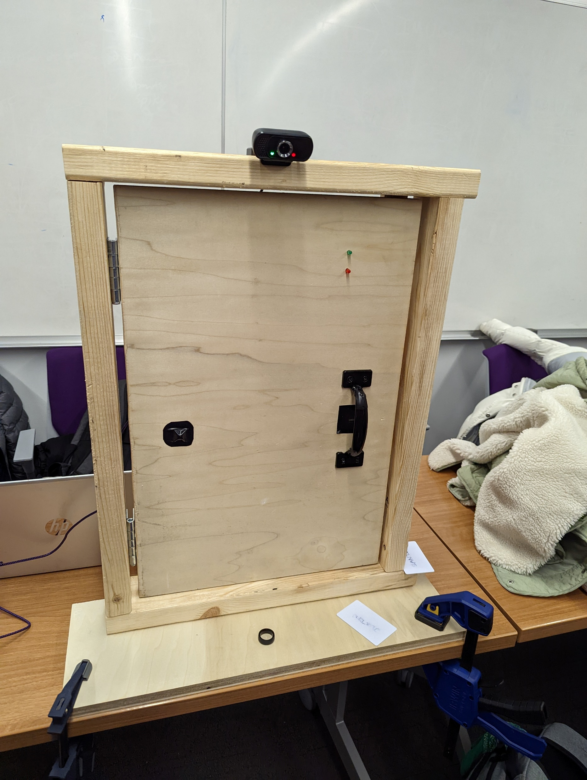
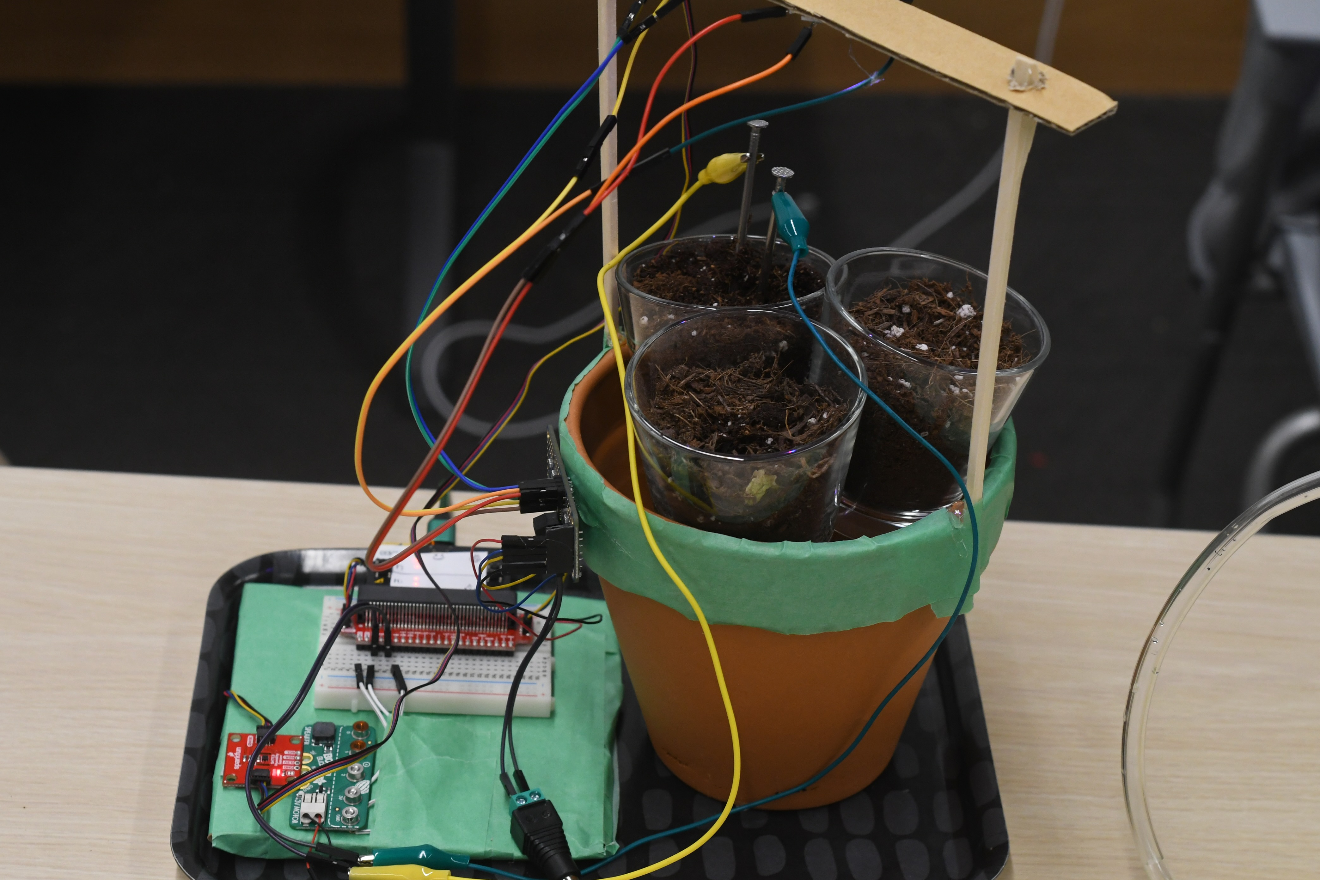
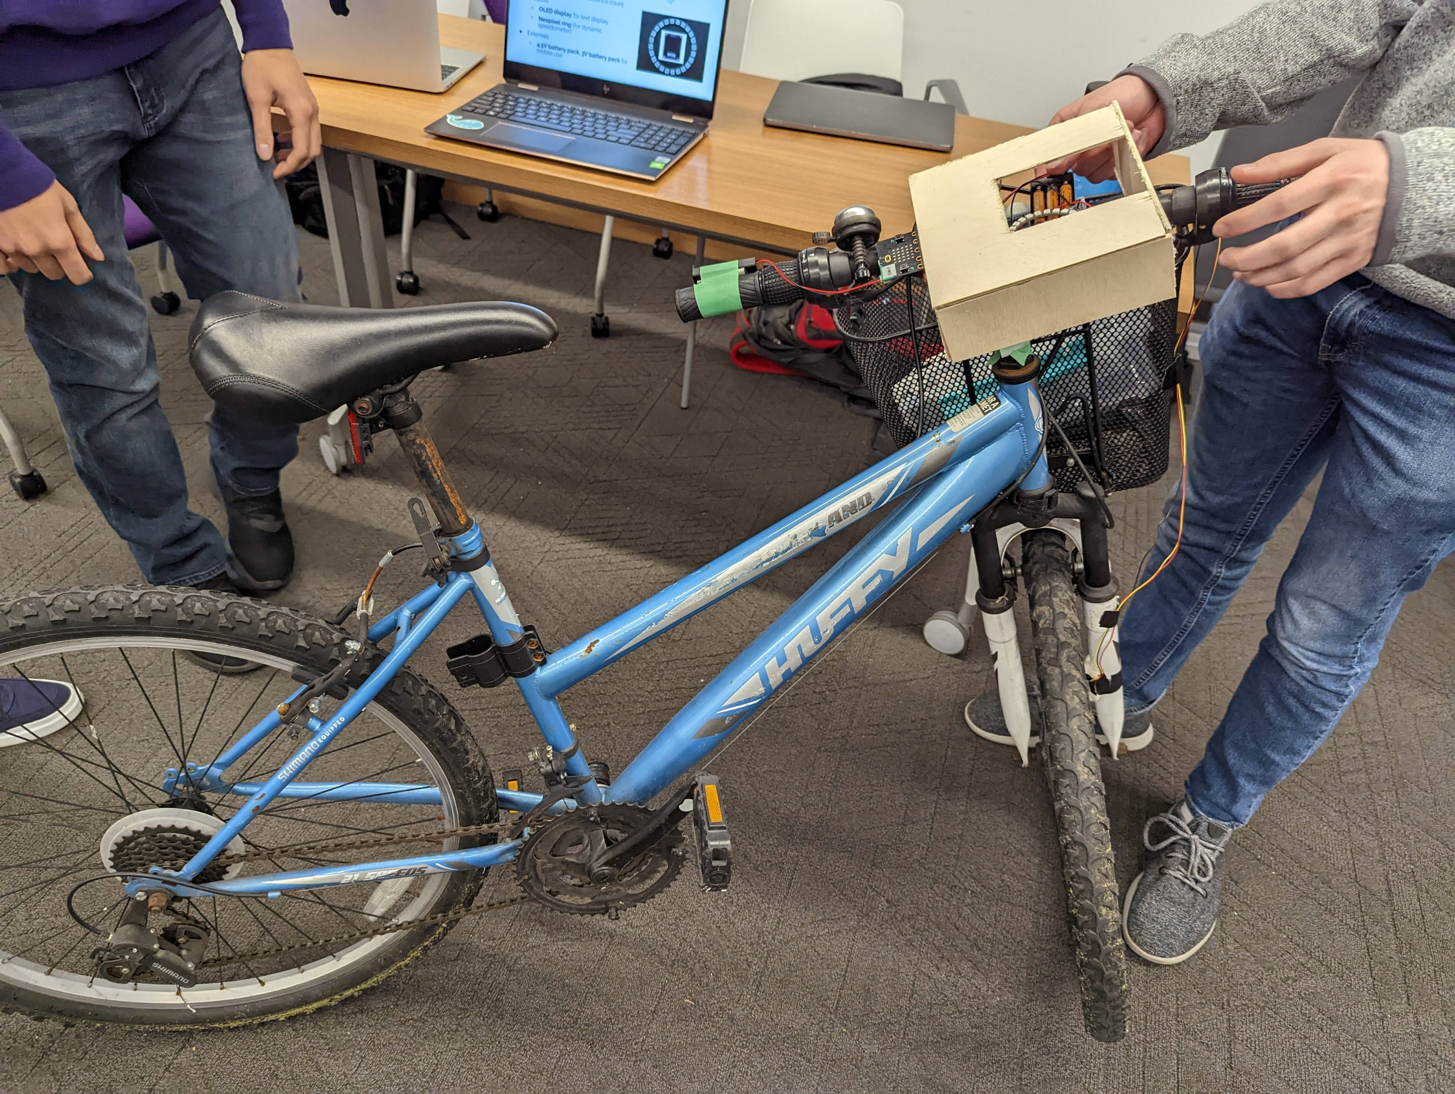
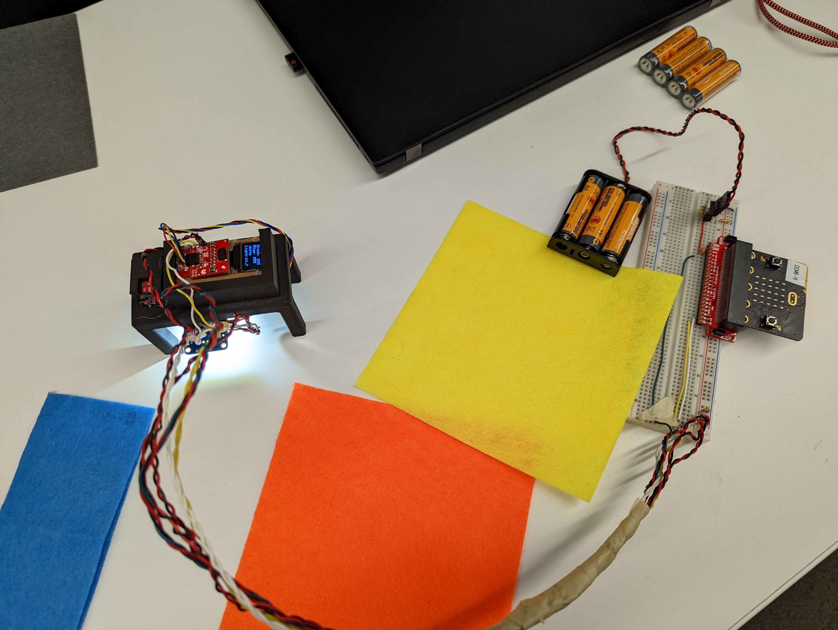
Some awesome Fall 2022 projects

Slide 54
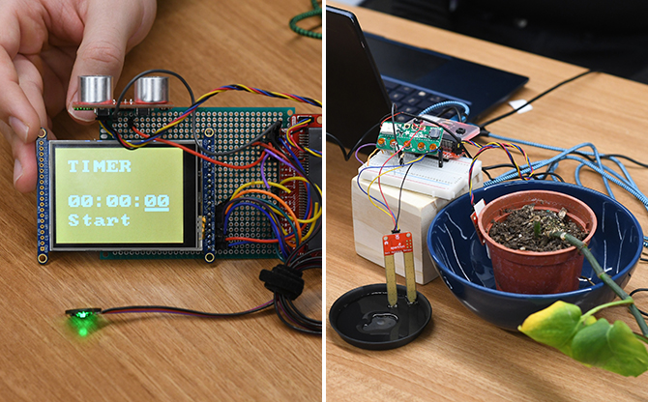
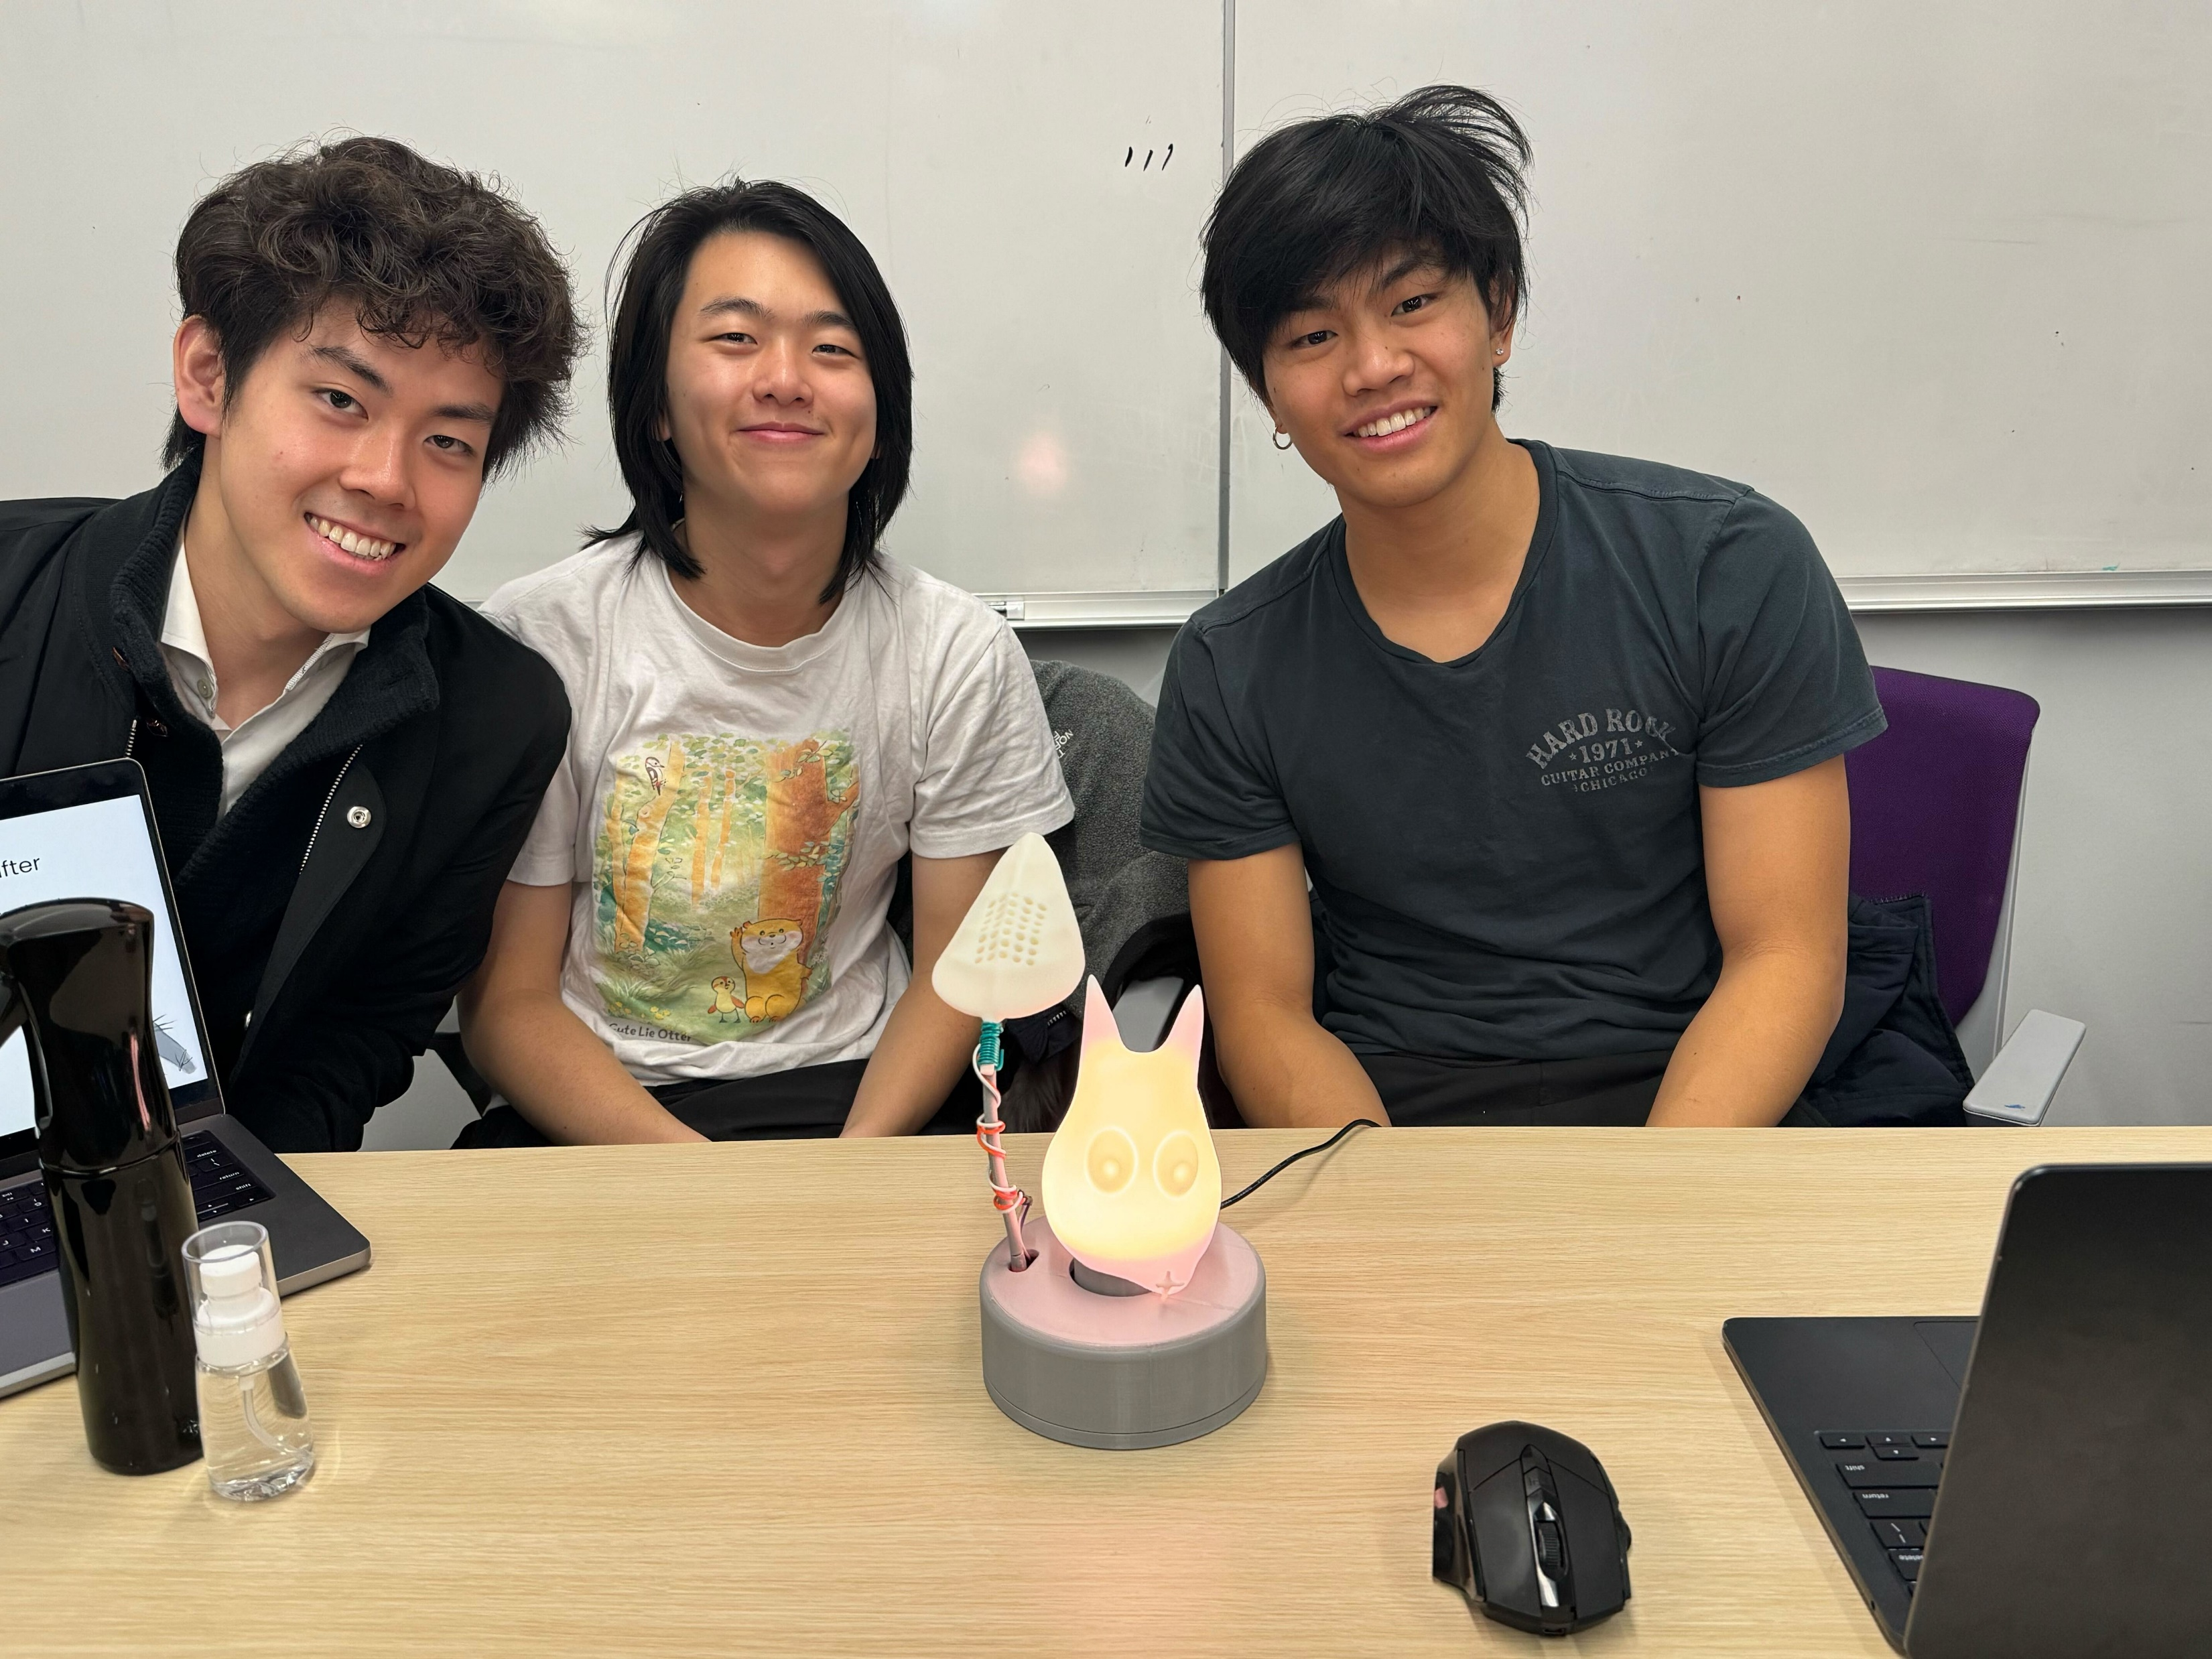
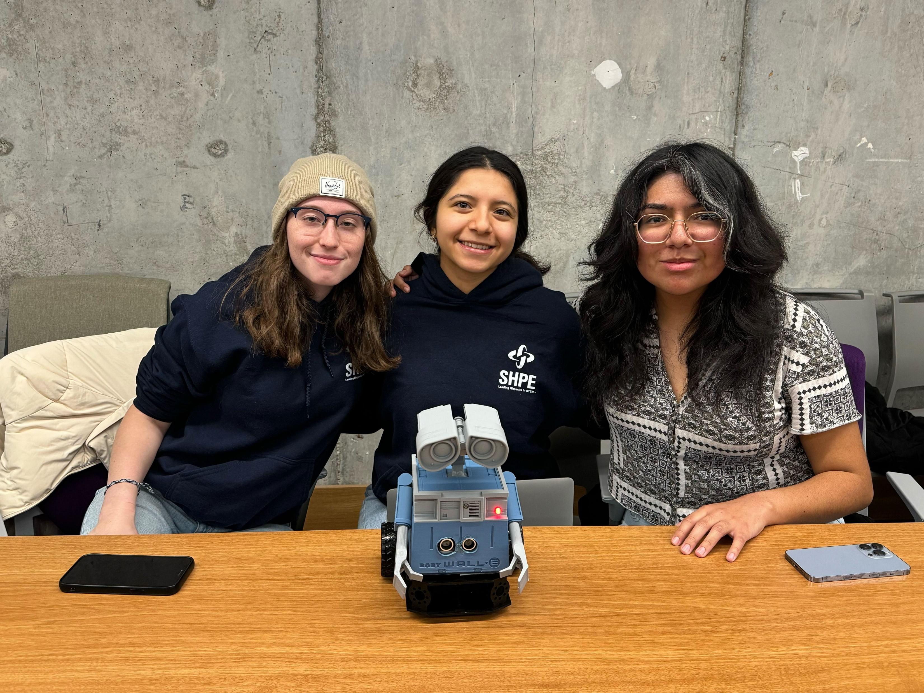
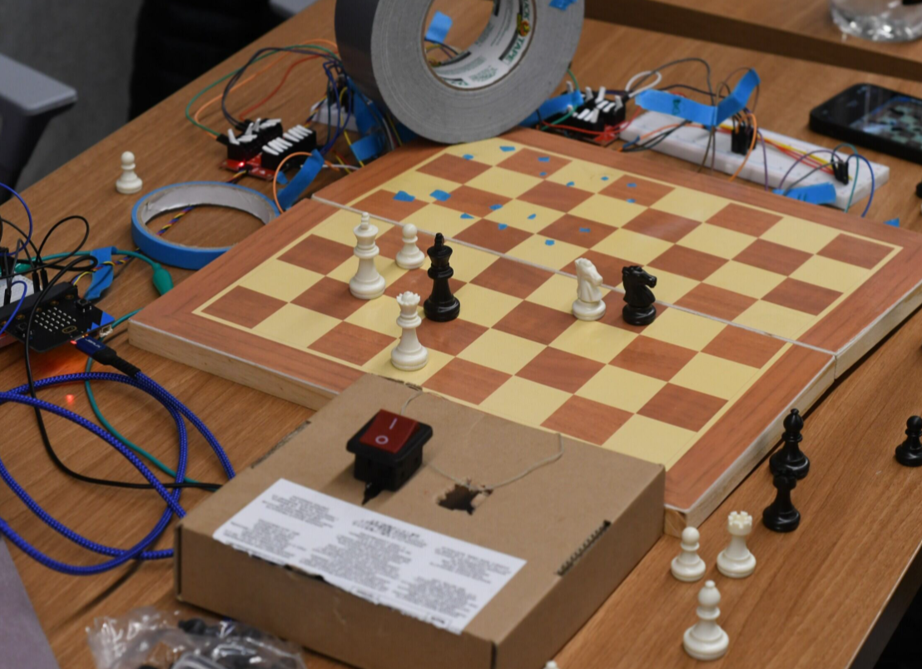
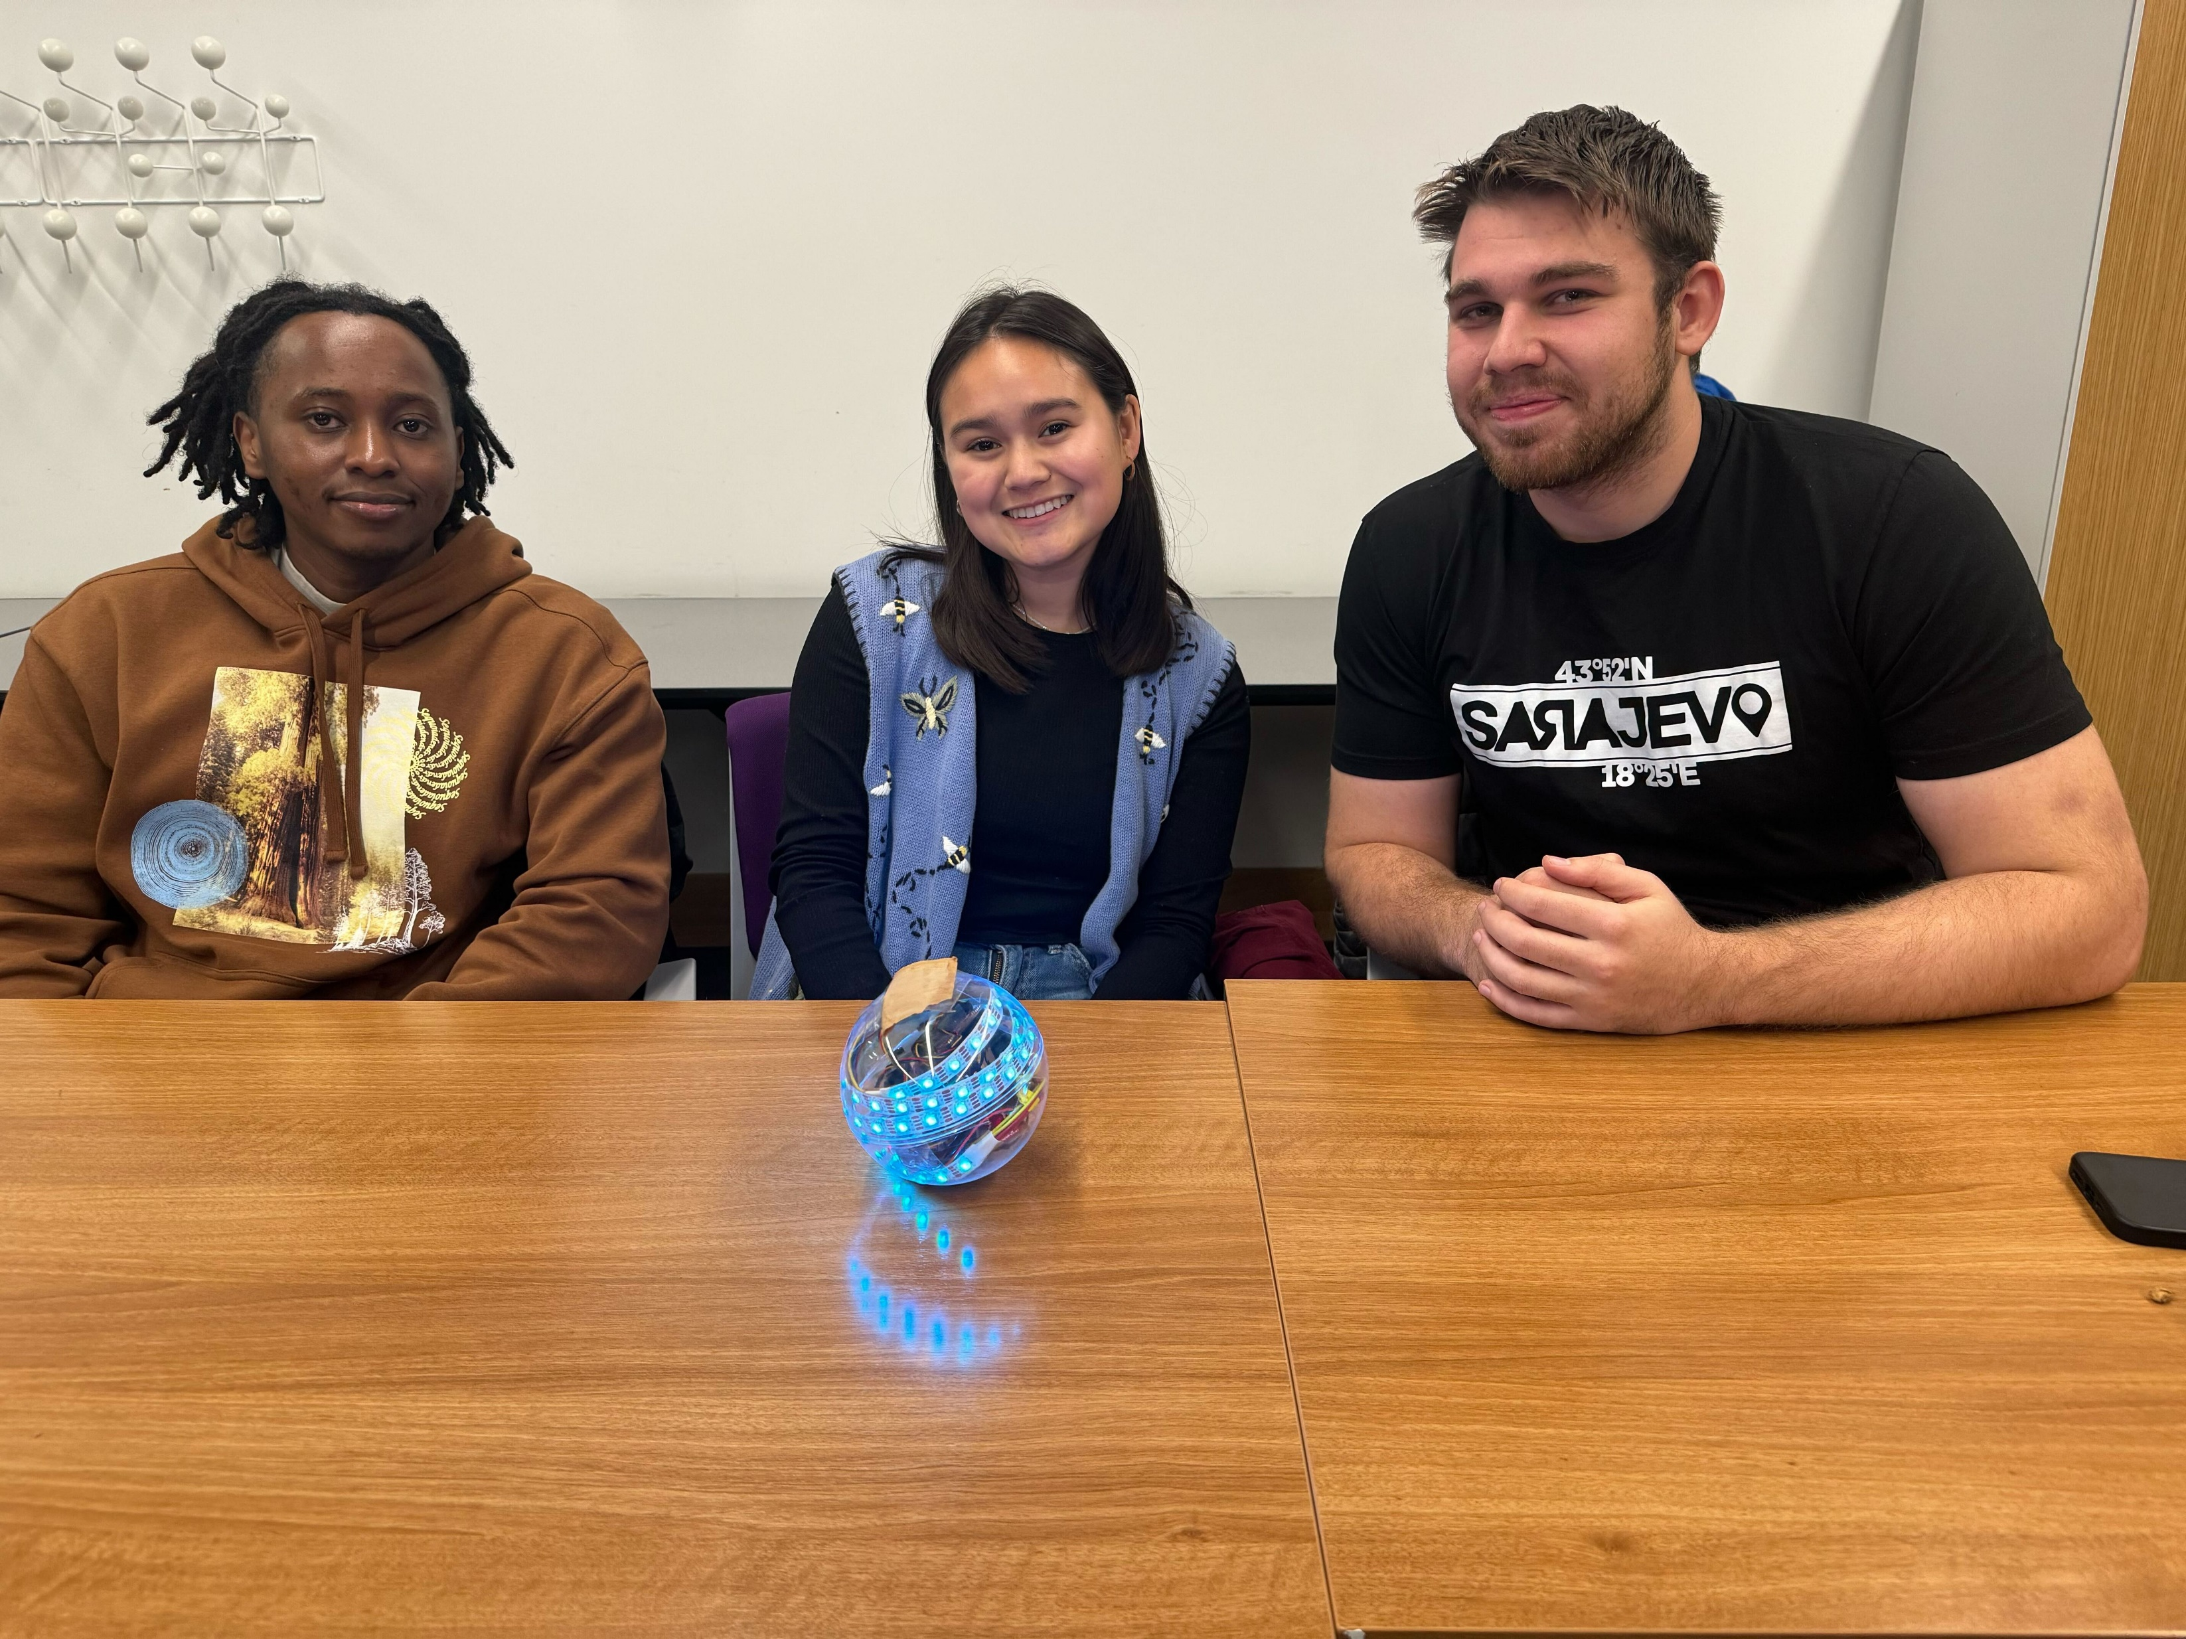

Some awesome Fall 2023 projects

Slide 55
Outline
Who and Why
Embedded Systems
Course Overview
Class Hardware
Project Ideas

Slide 56



Signpost – City-Scale Sensing
How do we reduce the burden of city-scale sensing experimentation?
Platform provides resources
Modules provide sensor and application

Slide 57


PowerBlade – Smart Home
Plug-load power meter
How do we measure every device in a home?
Challenges
Deployability
Powering it
Sensing AC current and voltage
Reporting measurements
https://www.youtube.com/watch?v=oNUXhCDnHoE

